Slide 1
Ciencia de los materiales
NO METALES
DAVID CAMPOS RODRIGUEZ
1889150
Grupo:013
Salon:1305

Slide 2
NO METALS
Non-metals are chemical elements that are not good conductors of electric current and heat, are very weak so they can not be stretched or converted into a sheet.1
Of the 118 elements that are known, only 25 are non-metals; its chemistry, unlike metals, is very diverse, although it represents a very small number, most of them are essential for biological systems (oxygen, carbon, hydrogen, nitrogen, phosphorus and sulfur). The group of non-metals includes halogens 1 (fluorine, chlorine, bromine, iodine, astatine and tenesus) that have 7 electrons in their last layer of valence, the noble gases (helium, neon, argon, krypton, xenon , radon and oganeson) that have 8 electrons in their last valence shell (except helium, which has 2), therefore, this layer is complete and they are not very reactive. The rest of non-metals belong to different groups and are: hydrogen, carbon, sulfur, selenium, nitrogen, oxygen and phosphorus. The unique properties of hydrogen separate it from the rest of the elements in the Periodic Table of Elements.

Slide 3
CHARACTERISTICS
Non-metals vary greatly in appearance, are not glossy and are generally poor conductors of heat and electricity. Its melting points are lower than those of metals (although diamond, a carbon form, melts at 3570 ° C) .4 Several non-metals exist in ordinary conditions as diatomic molecules.
In this list 5 are included five gases (H2, N2, 02, F2 and C12), a liquid (Br2) and a volatile solid (I2). The rest of the non-metals are solids that can be hard like diamond or soft like sulfur. Unlike metals, they are very fragile and can not be stretched in threads or in a sheet.

Slide 4
DIFFERENCES WITH METALS
Non-metals tend to resemble the closest noble gases in the electronic configuration of their last layer. The less electronegative will have a tendency to lose electrons in front of more electronegative ones.
The reactivity of an element measures the tendency to combine with others.
Variation of the reactivity in the groups. The groups on the left are more reactive than those on the right since it is easier to lose an electron from the last layer than two, three ... When we reach a certain group the trend is reversed since it will be easier to gain electrons that they lack to resemble the nearest noble gas.8 Therefore, in a period.
The reactivity of the metals increases the further to the left in the period (fewer electrons to be removed).
The reactivity of non-metals increases as the period progresses (fewer electrons to be picked up).
Variation of the reactivity in the groups. As we descend into a group, the electrons in the last layer are farther from the nucleus and, therefore, it will be easier to remove them and, in the case of non-metals, harder to catch electrons.
The reactivity of metals increases when advancing in a group (greater tendency to lose electrons).
The reactivity of non-metals increases the higher in the group (higher tendency to catch electrons)

Slide 5
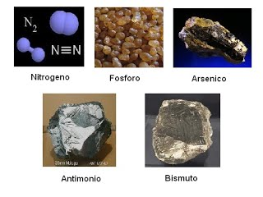
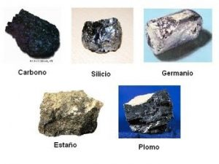
Types of no metals

Slide 6
referencias
Loyola, María Dolores de la Llata (2001). Química inórganica. Editorial Progreso. ISBN 9789706413512. Consultado el 10 de noviembre de 2017.
Volver arriba↑ Química I Primer Semestre Tacaná. IGER. ISBN 9789992292150. Consultado el 10 de noviembre de 2017.
Volver arriba↑ Antón, Juan Luis; Andrés, Dulce Mª; Barrio, Javier (2009-05). Química 2º Bachillerato. Editex. ISBN 9788497715904. Consultado el 3 de febrero de 2018.
Volver arriba↑ introduccion a la quimica descriptiva. Reverte. Consultado el 10 de noviembre de 2017.
Volver arriba↑ Antón, Juan Luis; Andrés, Dulce Mª; Barrio, Javier (2009-05). Química 2º Bachillerato. Editex. ISBN 9788497715904. Consultado el 3 de febrero de 2018.
Volver arriba↑ Quimica. Pearson Educación. 2005. ISBN 9789702606949. Consultado el 10 de noviembre de 2017.
Volver arriba↑ Sepúlveda, Tania Volke (2005). Suelos contaminados por metales y metaloides: muestreo y alternativas para su remediación. Instituto Nacional de Ecología. ISBN 9789688174920. Consultado el 3 de febrero de 2018.
Volver arriba↑ Perlado, Francisco Javier Guerra; Andrés, Dulce María (6 de octubre de 2014). Formación Profesional Básica - Ciencias Aplicadas I. Editex. ISBN 9788490039700. Consultado el 10 de noviembre de 2017.
Volver arriba↑ Quimica. Pearson Educación. 2005. ISBN 9789702606949. Consultado el 10 de noviembre de 2017.
Volver arriba↑ Quimica. Pearson Educación. 2005. ISBN 9789702606949. Consultado el 10 de noviembre de 2017.

